Slide 1

Home Brewing Inspired
Automated Proof of Concept
Joseph Coria (Team Leader)
Daniel Quenga
Jason Davis
Michael Sabate
May 5, 2018
Notes:
Joseph

Slide 2
Overview
Project Statement
Objectives
Motivations
Background
Previous Design Ideas
Important Design Components
Engineering Analysis
Final Design
Final Product
Conclusions
Questions
Notes:
Joseph

Slide 3
Project Statement
To design and fabricate a user-friendly, cost effective proof of concept that accomplishes all actions required for an automated home brewing system, including regulating liquid temperature and moving liquid between containers.
Notes:
Daniel
Read word for word

Slide 4
Objectives
Regulate Temperature at two stages (boiling and steeping)
Move liquid between containers based on temperature feedback
Cool liquid from boil to below 80°F
Produce a user-friendly HMI
Design a system with minimum set-up and clean-up times
Run a to-scale process (~9 minutes) with water for demonstration purposes
** Detailed ingredients for a real brew process are not being included; only water is being heated, cooled, and circulated.
Notes:
Daniel

Slide 5
Project Motivations
There is a need:
for a cost effective automated home brewing system.
for an automated home brewing system with simplified user inputs. Thus, opening homebrewing to consumers with little knowledge of the process.
for an entry level automated home brewing system.
to reduce the user input time for the home brewing process.
to reduce the risk of user error.
to increase the degree of repeatability in the process.
Notes:
Michael

Slide 6
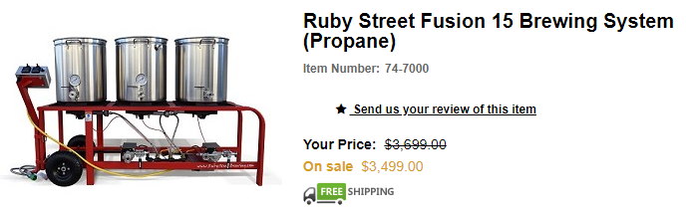
Home Brewing Background
The homebrewing market contains a variety of products to satisfy a wide spectrum of beer enthusiasts.
The homebrewing of beer has existed since the beverage was invented. Now a surge in interest for consumer homebrewing has risen due to the popularity of craft brews as well as the existence of ideas like crowdfunding.
As with the greater beer market , there exists a variety of consumers interested in homebrewing. Consumers vary from D.I.Y. hobbyists to product-oriented casual brewers seeking simple, turnkey operation devices.
Notes:
Sabate

Slide 7
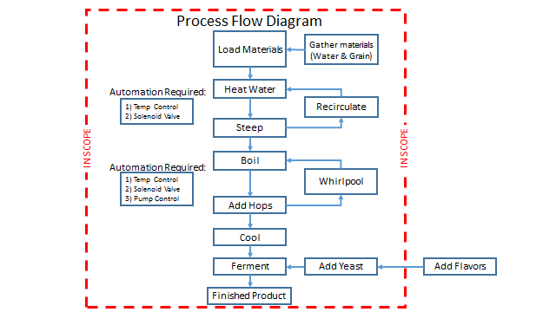
Homebrewing Process Flow
Notes:
Jason
Here is the complete process flow diagram which includes steps we are not modeling.

Slide 8
Proof of Concept Process Flow
20°C
Fill Tank 1 with water
Automation required:
Temperature control
Propane valve
Ignitor
Temperature feedback
Liquid valve control
Pump control
60°C
Steep
Transfer Liquid
110°C
Boil
70°C
Cool
Recirculate
Transfer Liquid
Ferment
Notes:
Jason
The level of automation implemented in our proof of concept is all that is required in the actual process
Our simplified process allowed us to create a model with all of the necessary actions and components to brew beer without the addition of brewing materials such as grains, hops, yeast, and flavors

Slide 9
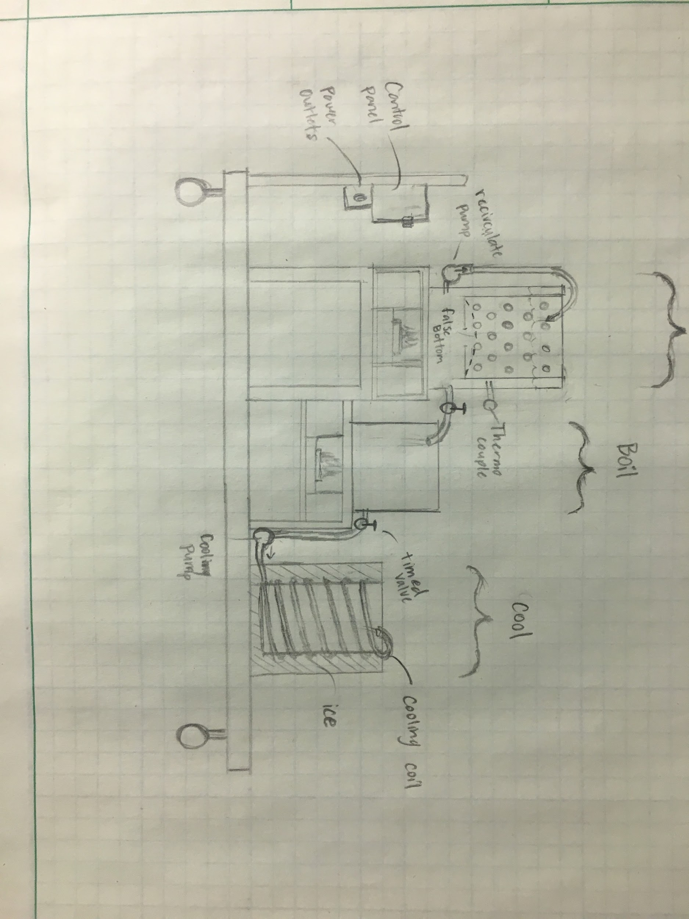
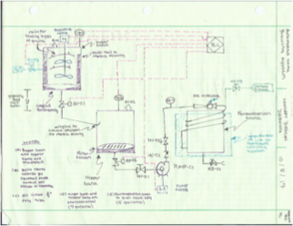
Previous Design Iterations
1. Steep
2. Boil
3. Cooling and Fermentation
Mechanical Agitation
Solids Filter
Gravity Feed Liquid Transfer
Single Pump for Cooling
Heating Source (Propane)
Added Frame Design
Solids Filter
Pump Over (recirculation)
Heating Source (Propane)
2 Pumps (Recirculation and Cooling)
Notes:
Joe C

Slide 10
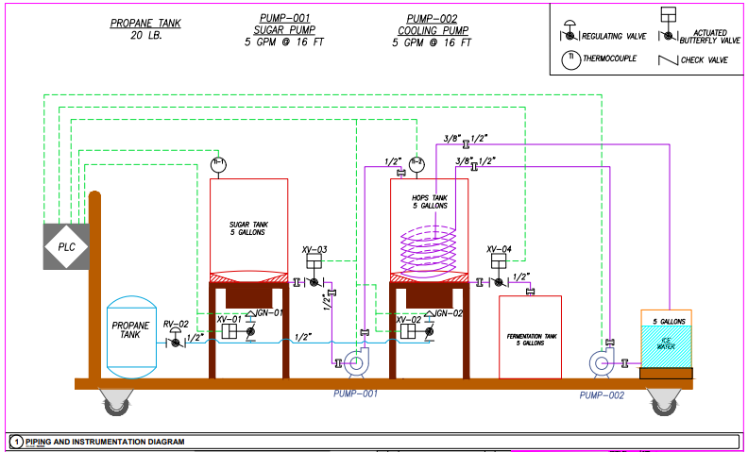
Final Design
Notes:
Joe C

Slide 11
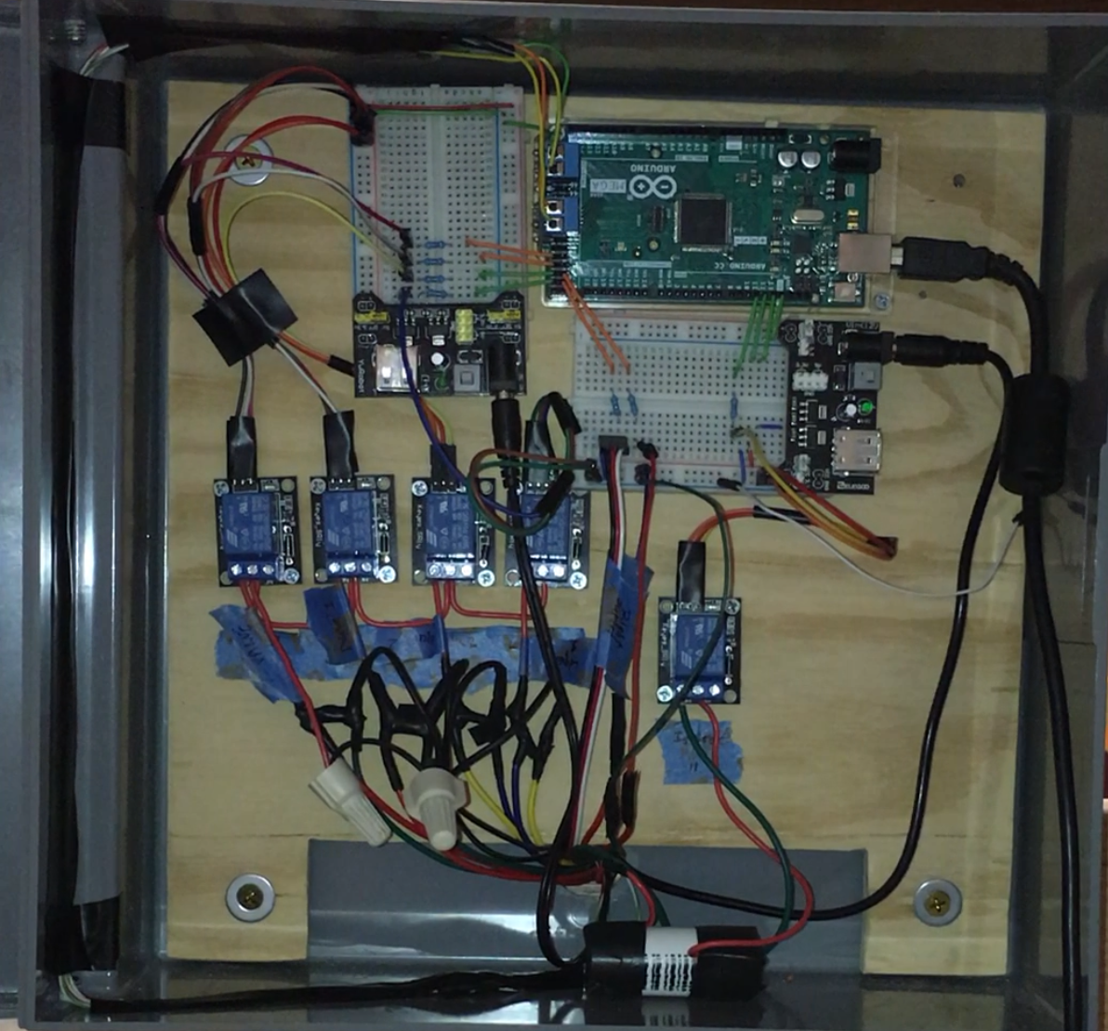
Control box components
Arduino Mega
Relays
Propane and liquid solenoid valves
Spark ignitor
Transfer and circulation pump
Thermocouples
Gauges temperatures in brew pots 1 & 2
Flame sensors
LCD screen
Displays temperatures and current stage
Push button for software start-up
Powerstrip for mechanical E-stop
Arduino controller
Breadboard with 5v power supplies
Relays in series
Notes:
Sabate

Slide 12
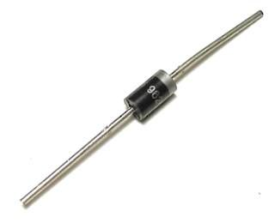
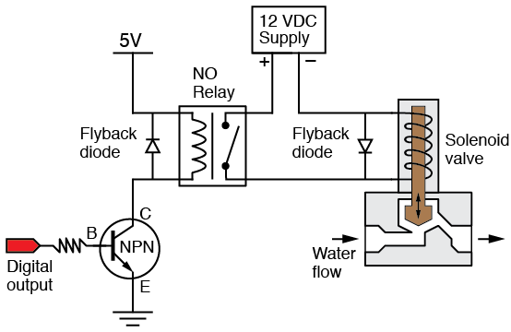
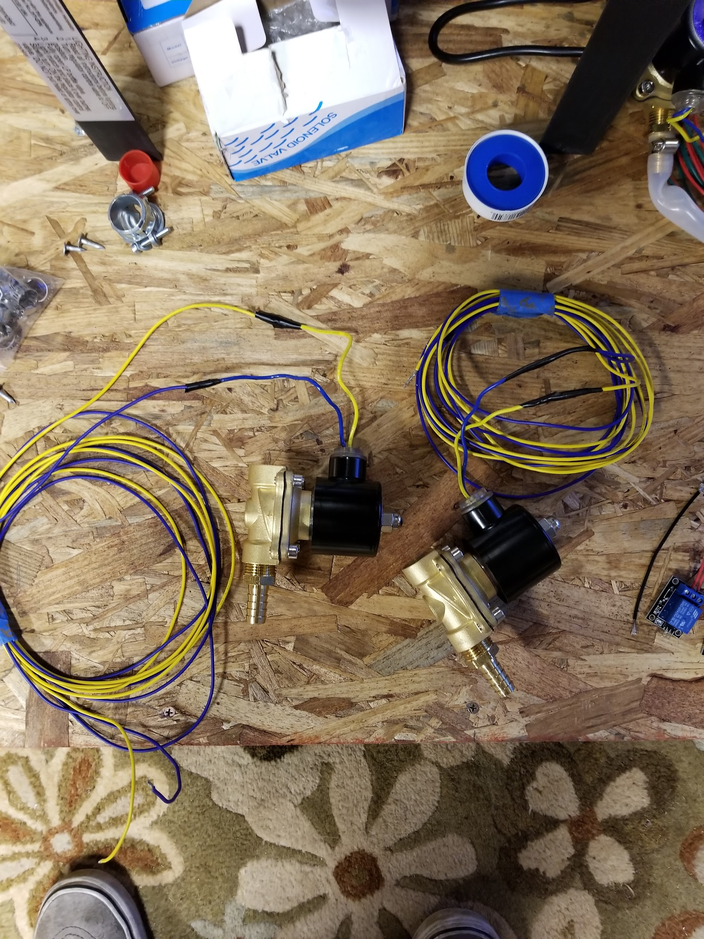
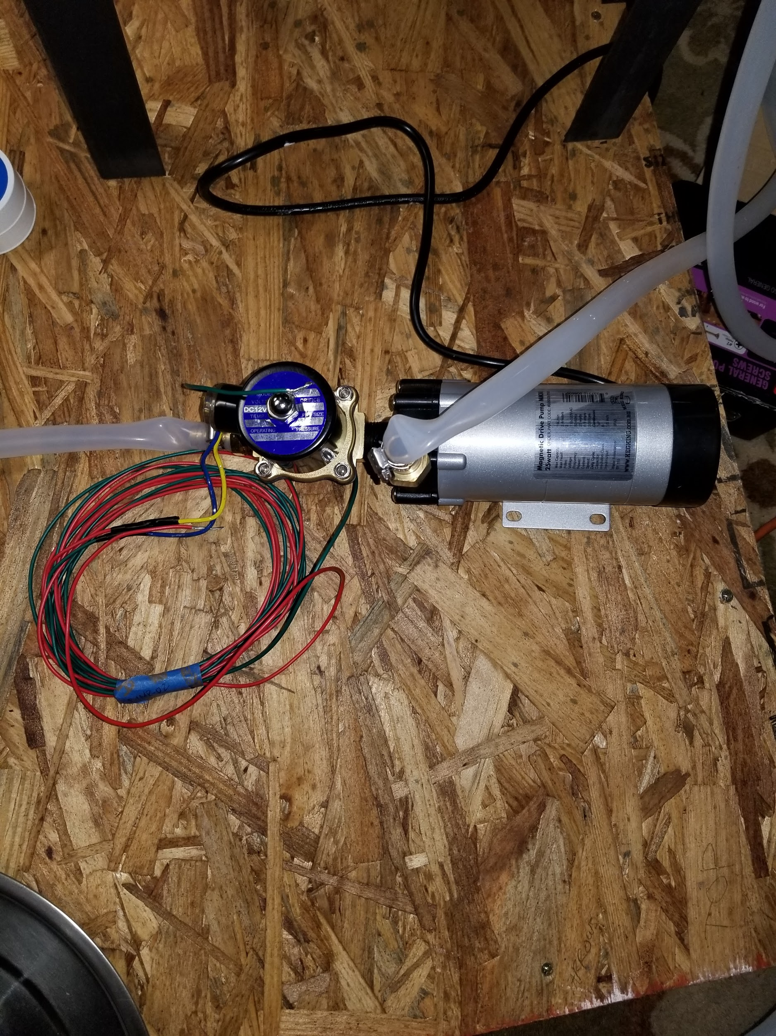
Solenoid Valves
12VDC Normally closed Solenoid Valves
Total of 4 valves
2 for liquid transfer
2 for propane heating
Solenoid Valves normally closed
Flyback Diode used to protect relay
Notes:
Sabate

Slide 13
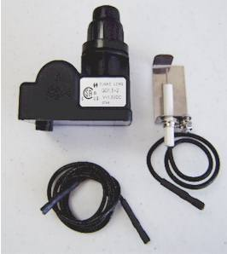
Electronic Spark Ignition
Converted manual push button to Arduino controlled electronic switch through relay
AA battery used to charge ignitor coil
Simple and reliable
Electrode ends mounted on brackets and extended into burner enclosure
Notes:
Daniel

Slide 14
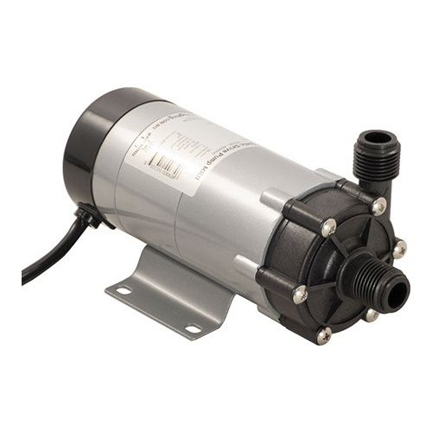
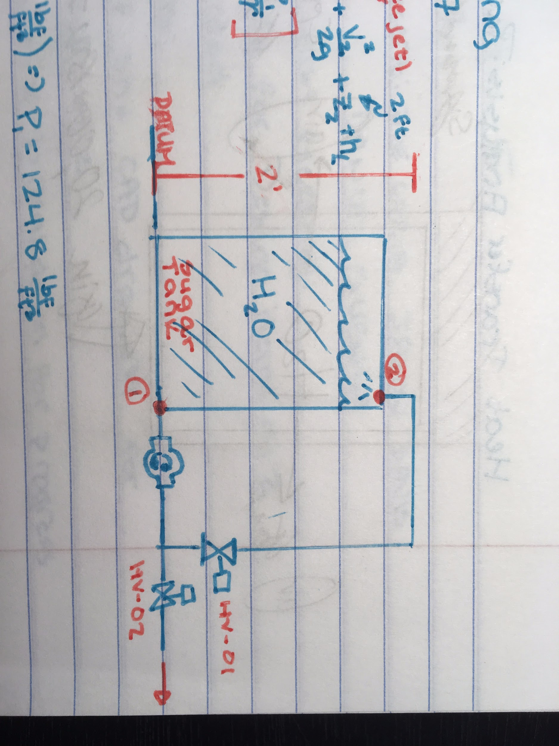
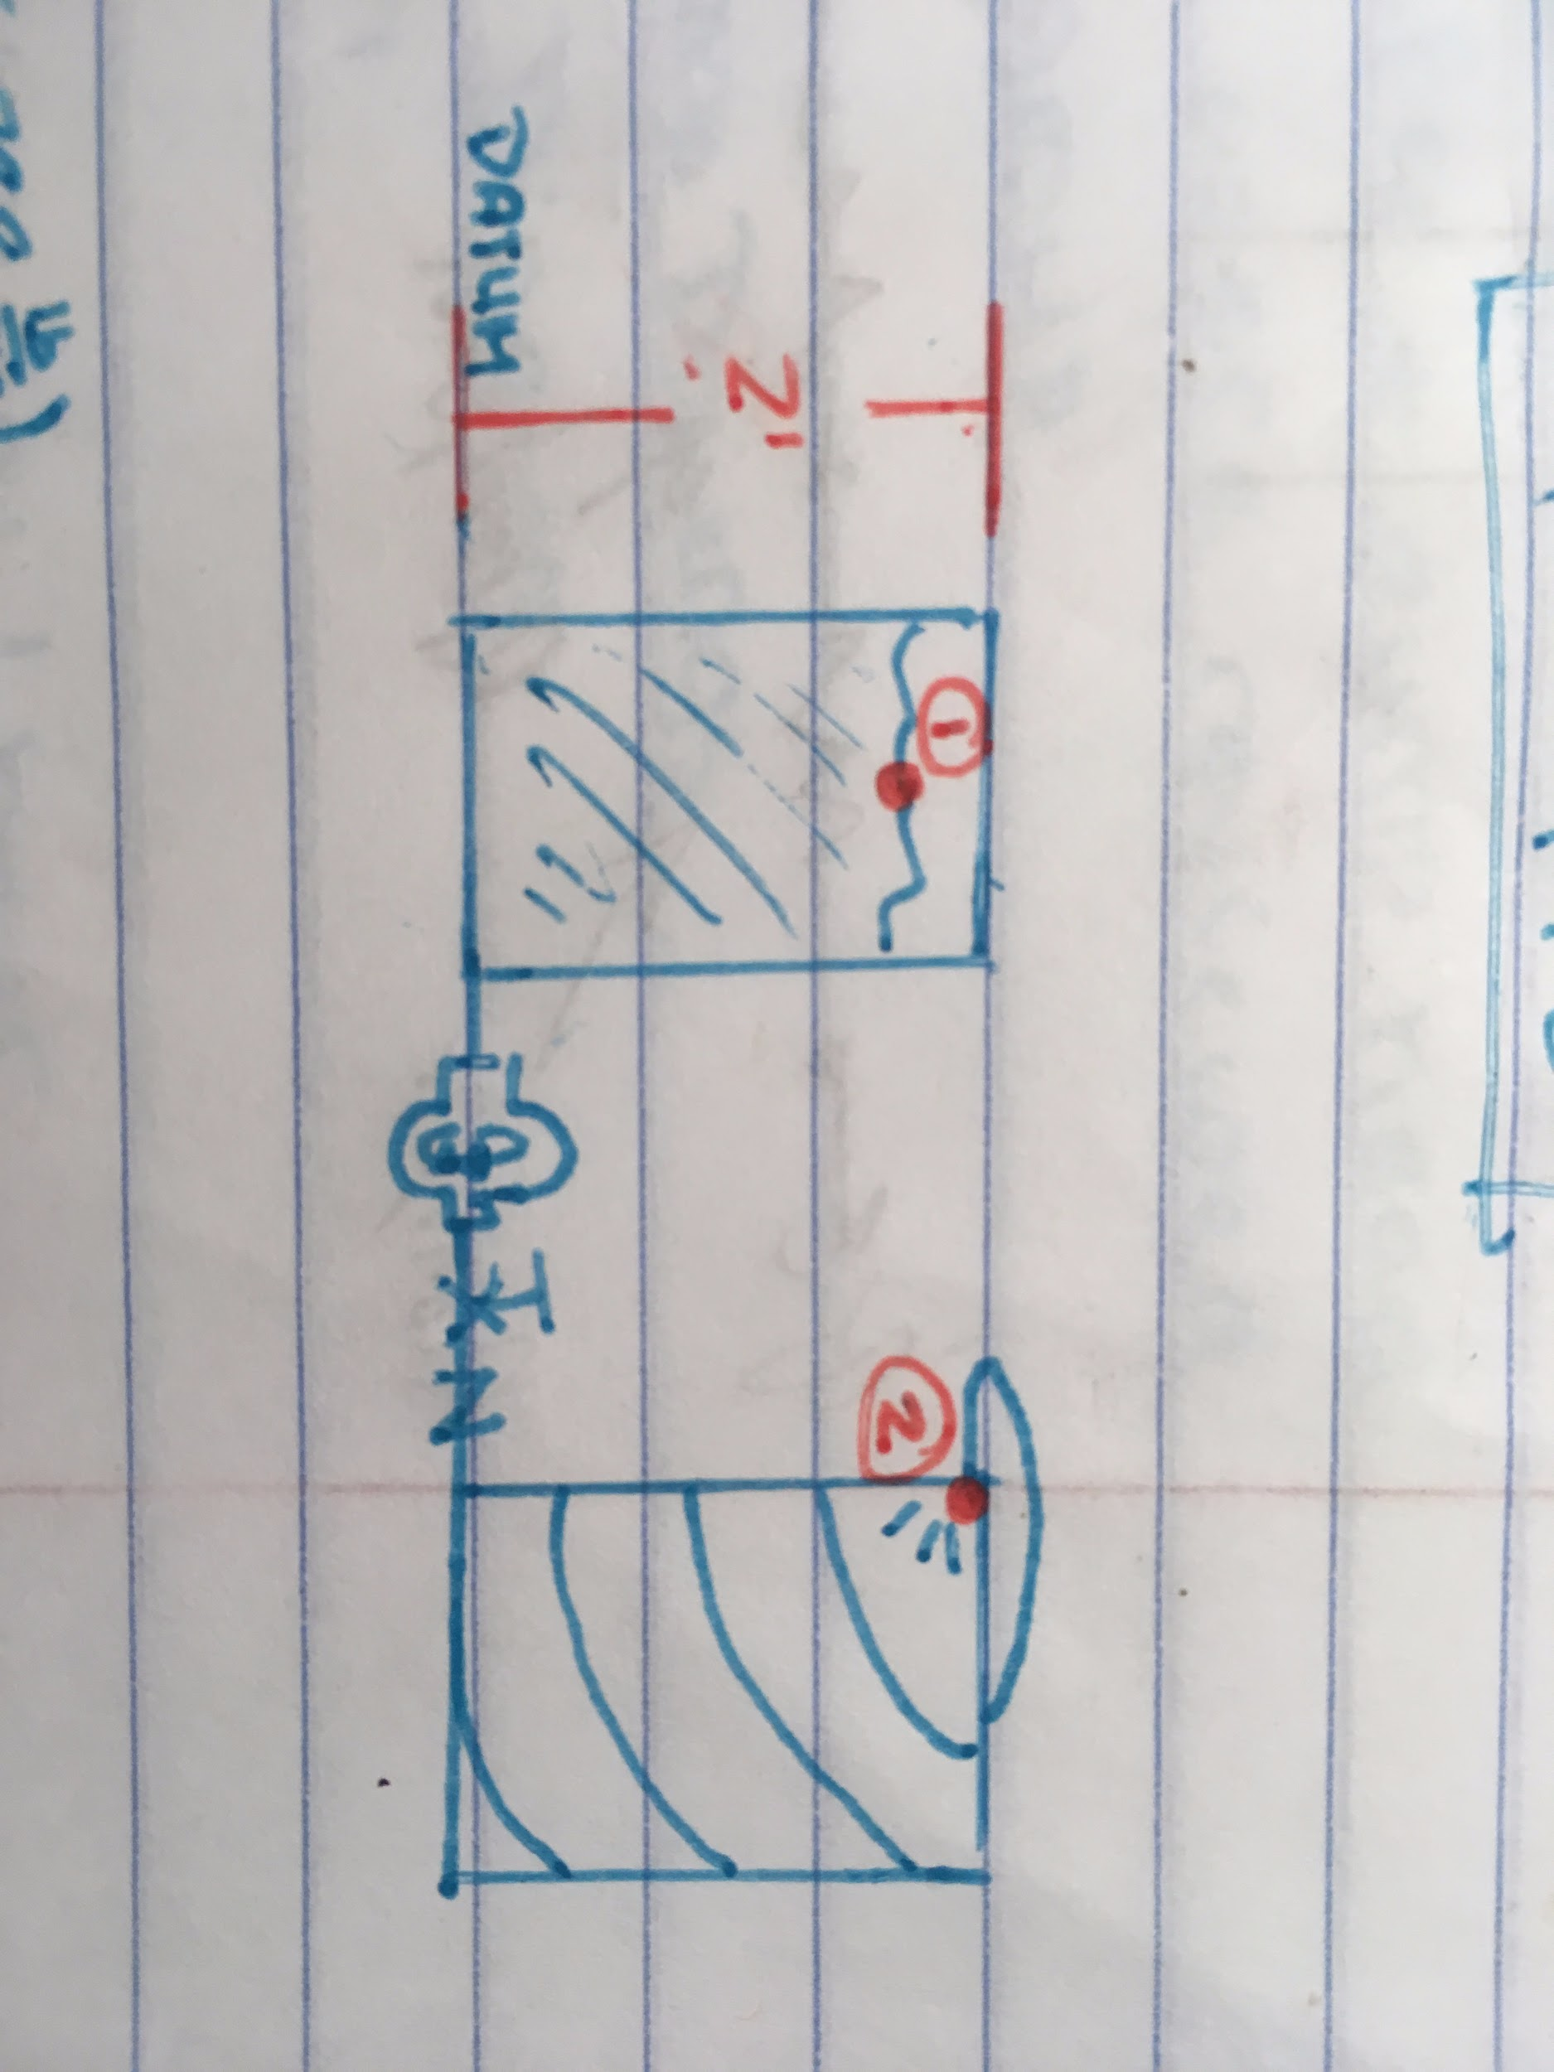
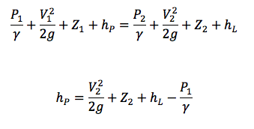
Fluid Transfer Analysis
Assumptions:
½” Polytube: -8.8 psi/100 ft
Steep Tank:
10 ft of tubing
Z Change: 2 ft
Cooling Tank:
30 ft of tubing
Surface pressure: Free jet
Calculated Head pressure:
Pump 1 : 9 ft
Pump 2 : 12 ft
MARK II Wort Pump specs:
Max Head: 18.6 ft
Max Flow: 5 GPM
Can Handle up to 248 °F
Power: 115 V
Steep Tank
Bernoulli’s Equation
The selected pump meets our design requirements for both cases
Cooling Tank
Notes:
Daniel
https://www.ebay.com/itm/MKII-High-Temp-Magnetic-Brewing-Beer-Pump-by-Keg-King-1-2-mpt/282550420994?hash=item41c9514602:g:WbgAAOSwJ4hY97Wp
Chugger pump ss-inline ($140 ea)
https://www.homebrewing.org/Chugger-Pump-SS-Inline_p_3194.html?utm_source=google&utm_medium=shopping&gclid=EAIaIQobChMIlNSnlLfg1wIVhhobCh0n2QtUEAkYCiABEgIp2_D_BwE

Slide 15
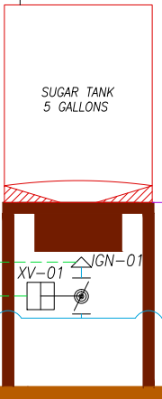
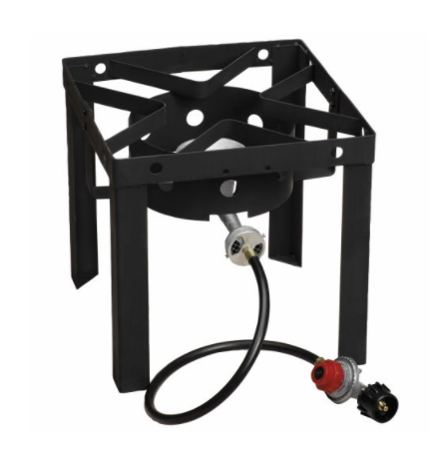
Heat Transfer Analysis
Assumptions
55,000 BTU/h propane Burner (16.12 KW)
η=60%
Volume = 5 gallons
18.9 kg
Constant properties through heating
Heat lost due to convection to air is negligible
T_{i} = 20℃
T_{f} = 100℃
q
Notes:
Jason

Slide 16
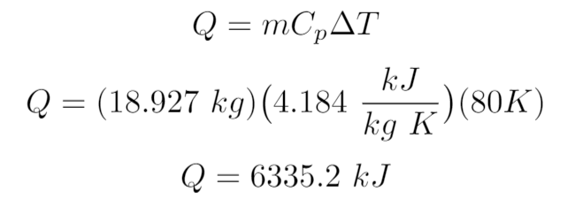
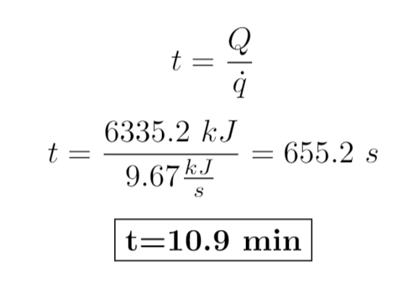
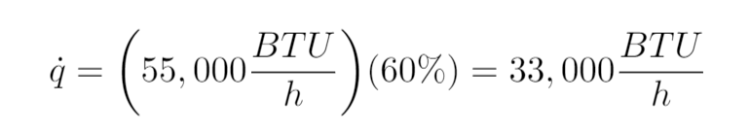
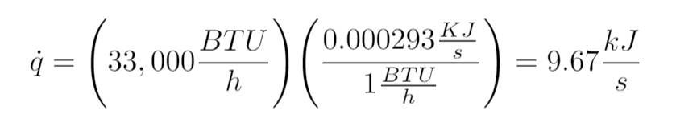
Heat Transfer Analysis
Energy Required to heat water:
Time required for heating:
Heat rate of propane burner:
Unit Conversion:
q
Notes:
Jason

Slide 17
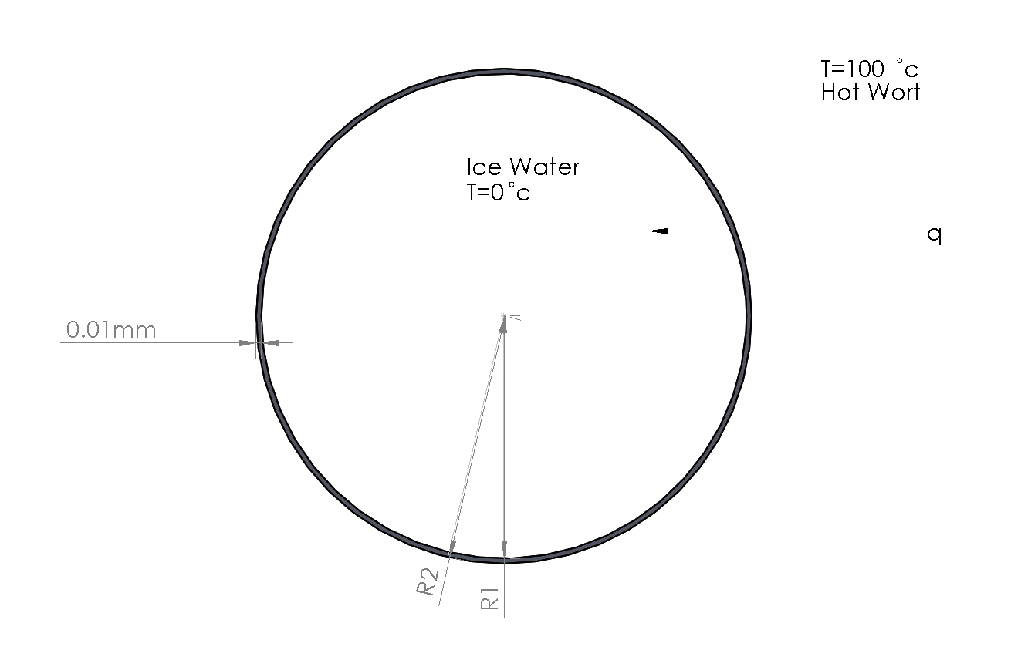
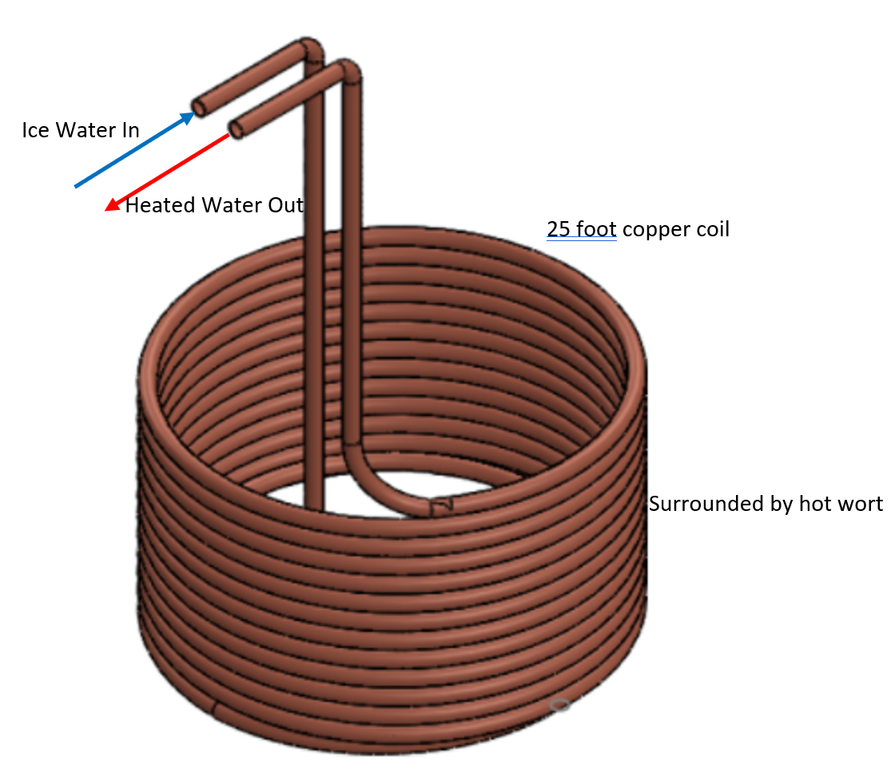
Heat Transfer Analysis-Cooling Coil
Find: Exit temperature of cooling water flowing through coil
Notes:
Joe C
Known:
The fluid conductivity , and initial temperatures of the water and wort volumes. The volumetric flow rate, cross sectional area and length of cooling coil. Additionally the conductivity of the coil material (copper) is known.
Find:
Convective coefficients of the wort and water fluids
Heat rate during cooling cycle
Total heat required to reach desired temperature of 30 degrees celsius
Total time required to complete cooling cycle

Slide 18
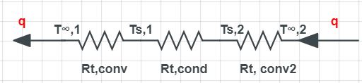
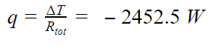
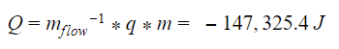
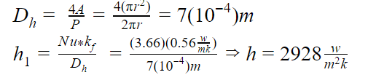
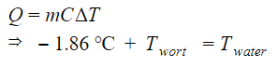
Cooling Coil-Thermal Resistance
Assumptions
Uniform temperature distribution in both liquid bodies
Temperature of cooling liquid remains at 0℃ through cooling process
Forced convection
Fully developed laminar pipe flow (Nu=3.66)
Thermal Resistance Network:
-147.3 kJ
old
Notes:
Joe C
Reduce number of significant figures for Q
Add a note that incorporates Nu and how it is used to determine heat transfer coefficient

Slide 19
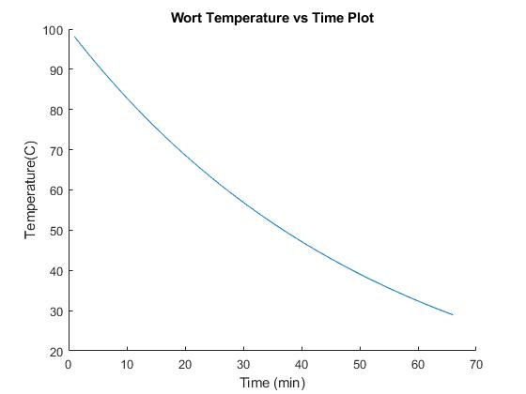
Cooling Coil Analysis
It will take 65 minutes to cool the hot liquid from 100℃-30℃
Cooling will use 5 gallon of ice-water
~5 GPM through cooling coil
Notes:
Joe C

Slide 20
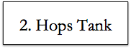
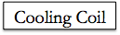
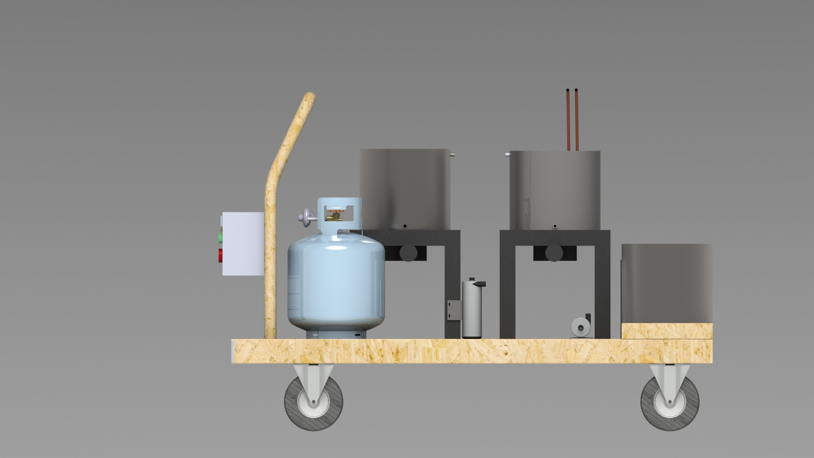
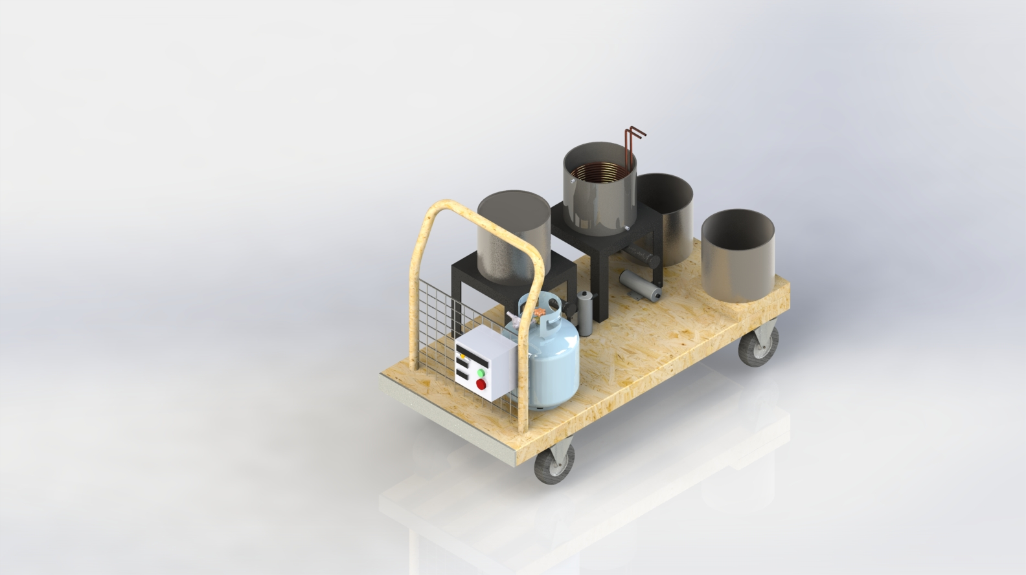
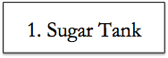
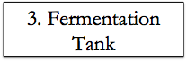
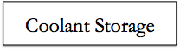
Final Design
3D-Rendered SolidWorks Design
Notes:
Sabate

Slide 21
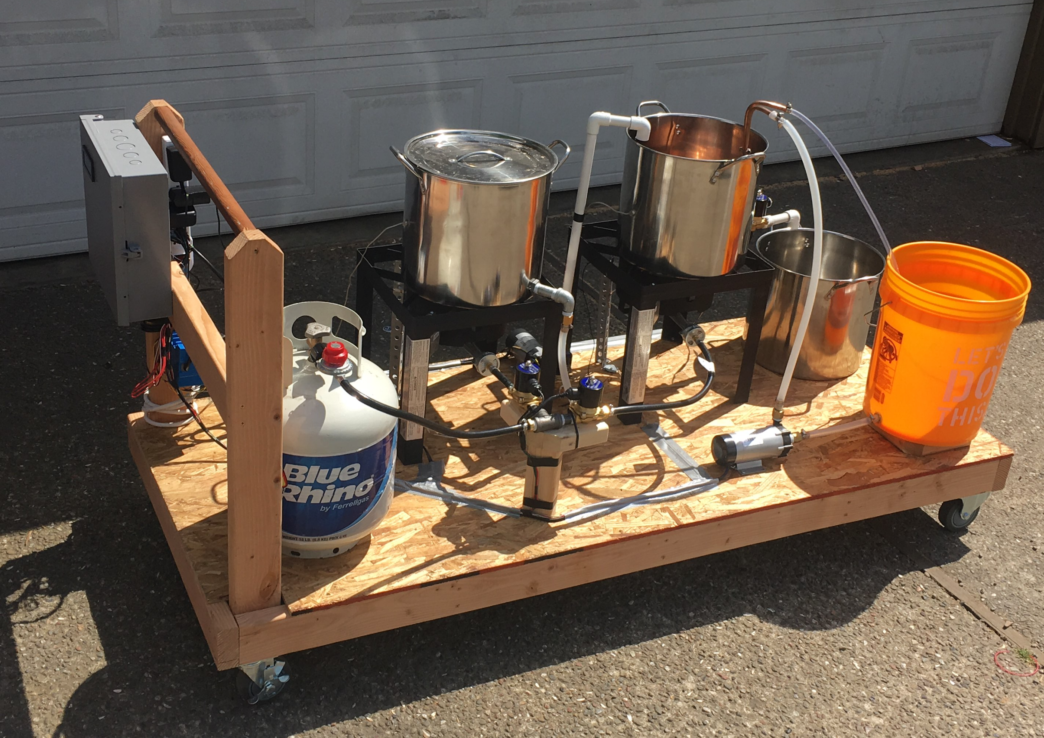
Final Assembled Product
Notes:
Sabate

Slide 22
Safety Considerations
● Propane burners:
○ Propane burners will have a flame sensor feedback loop
■ If the flame goes out the propane feed will be shut off
○ The failure state of the propane feed valves will be closed
■ If the system loses power the propane feed will be shut off
● Hot points of contact will be labeled or insulated
○ Propane burner flames will be guarded
Notes:
Jason
RPN numbers from handout if we want to include failure modes

Slide 23
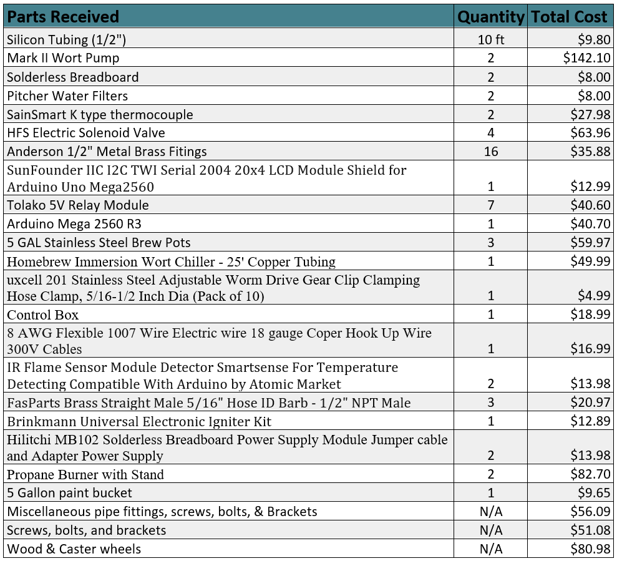
Budget
Total working cost of parts used for the project is $883.26
Notes:
Jason
Move current market brewing system to background slide for comparison
Table needs to be reformatted

Slide 24
Conclusions
An automated system capable of performing all necessary functions was constructed
A temperature feedback loop was used at two stages
The cooling coil was used to recirculate water at 0℃ to cool the hot liquid in the hops tank
Notes:
Daniel

Slide 25
Future Improvements
Mechanical
Include a refrigeration system for cooling the hot fluid with higher efficiency
Exchange all silicone tubing areas for hard pipe
Quick release fittings for pots for easier cleaning
Add agitator in both tanks for uniform temperature distribution
Sloped bottom tanks for full drainage of liquid
Reduction of dead leg in fluid lines
Food Safety
Food safe welds and fittings in all necessary areas to be safely used in homebrewing applications
Electrical and Controls
Compact 8 channel relay board
Level sensors in tanks for pump timing
Higher quality thermocouples
Notes:
Daniel

Slide 26
Any Questions?
Notes:
Fin

